Slide 1

Employee Task Manager

Slide 2


The problem? (every solution needs a problem to be relevant)
Why do we need a Task manager in the first place?
Confusion arises when employees don’t know what task they need to work on
Employee might overlap each other on certain task with repetition happening
Employee might end up wasting more time than what is needed on work they aren’t assigned on
Employer valuable resources might get wasted on confused employees working out of sync
As an employer or admin, it is difficult to track what is assigned to whom and what has been completed and what needs to be worked on

Slide 3

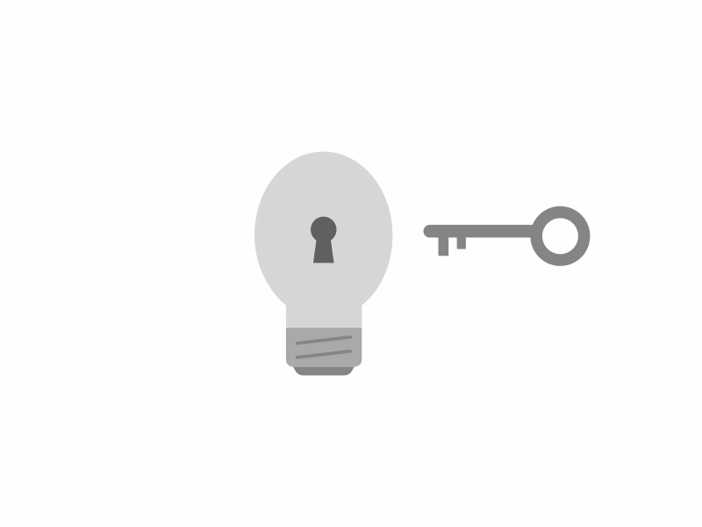
The solution & benefits
Better time management
Better tracking of task
Understanding what is active and needed to be done
Almost no chances of congestion and overlapping
Saving time and valuable resources
More synchronization
Less confusion

Slide 4
Overview
In this project, we’ll focus on building a Task Management system for employees.
The main goal is to create an application that allows a user to login and create a task, update and delete the tasks that they have created.
The tasks that are created are managed and saved in an external database, therefore it can be accessed from any windows machine by logging into the application.

Slide 5
Project Description
Objectives.
Efficiently manage tasks by the users.
Ease of access by the user by logging to their account.
Perform CRUD operations on tasks.
Tasks being saved in the database so that it can be accessed later.
Shows different status of a task such as To-do, In Progress or Done.

Slide 6
Project Description
Expected Outcomes
Allows a user to view the task created at any time.
Stores all the created tasks in a database.
Avoids loss of information.

Slide 7
Project Description
Target Audience:
Educational institutions
Media and Entertainment
IT and Telecom
Real Estate and Construction
Travel and Hospitality
Students, project managers, daily active users

Slide 8
Project Highlights
Create, Read, Update, Delete task.
Shows the status of a task.

Slide 9
User Interfaces
Home page.
The description page explaining about the TaskMan application and where the application can get started.
Login Page
The page consist of input box for username and password to login.
Dashboard
Admin View - It contains the list of all the tasks available in the system.
User View - It contains the list of tasks created by that customer only.
Task Page
It is the page where the users can create a new task and update an existing tasks.

Slide 10
HomePage
The Home page is where the application gets started.
It has a button.
Let's Go
Clicking that button, takes you to the Login Page.

Slide 11
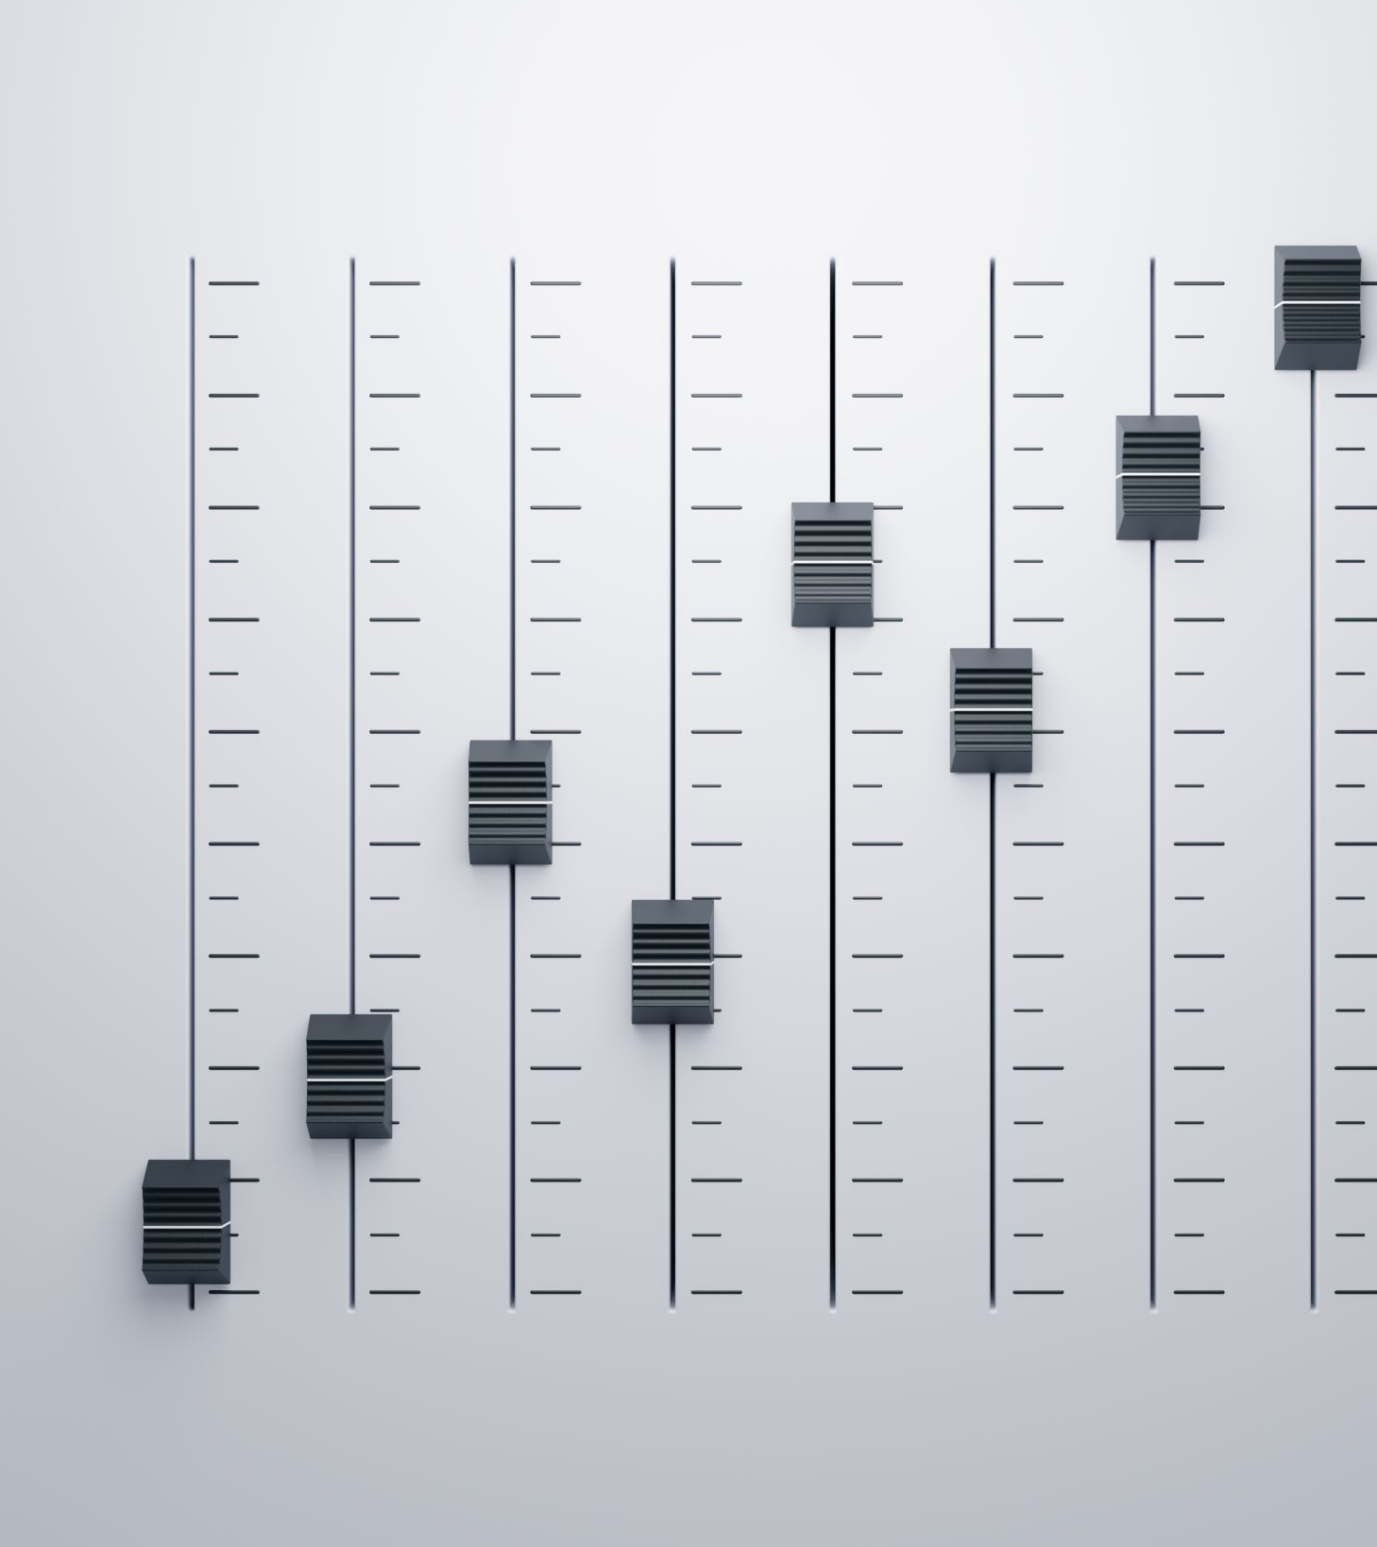
Dashboard
The Dashboard has two main views,
User View - It contains the list of tasks created by the customers.
Admin View - It contains the list of all the tasks available in the system.
It includes options such to Create, Edit and Delete tasks.
It includes individual task details like
Title
Owner (Only for admin view)
Status

Slide 12
Login Page
In the login page the user can enter their username and password to login.
It has two input buttons,
Username
Password
It consist of a button to click after entering the correct username and password.
Login
Clicking on the Login with correct username and password takes you to the next page.

Slide 13
Task Page
In the Task page, the user can create a new task by giving a Title for the task and the task description.
It has three input boxes,
Title
Description
Status
The new task created can be saved or cancelled.
It includes two buttons,
Save – To save the task entered
Cancel – To cancel the task entered

Slide 14
Roles
The application consist of two roles that are part of the system.
Admin
Customer

Slide 15
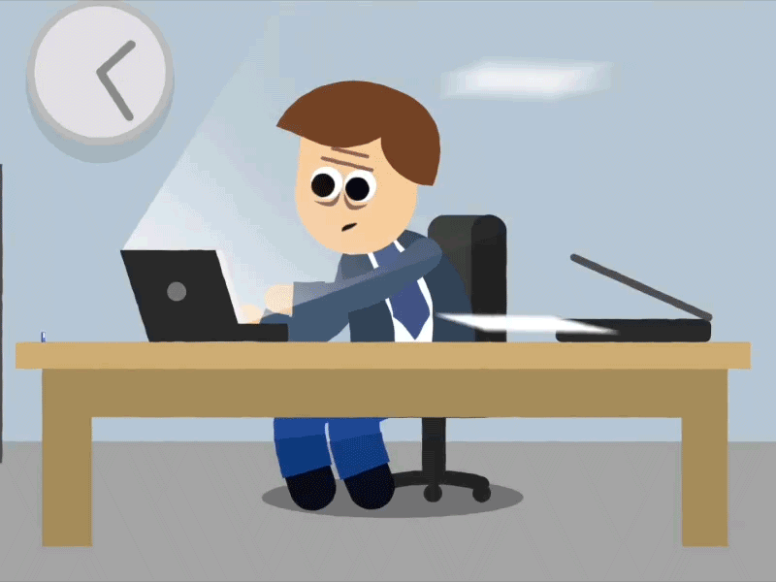
Admin
An Admin can view, edit and delete all the user’s tasks.

Slide 16

Customers
A Customer can view list of tasks created by them.
A Customer can create, update, and delete their own tasks users within the system.
A Customer cannot view, update or delete others user’s task.

Slide 17
Business Rules
The Administrator can create, view, update, and delete all the users.
The Customers can create, edit, delete tasks.
The Customers can view their own task only.

Slide 18
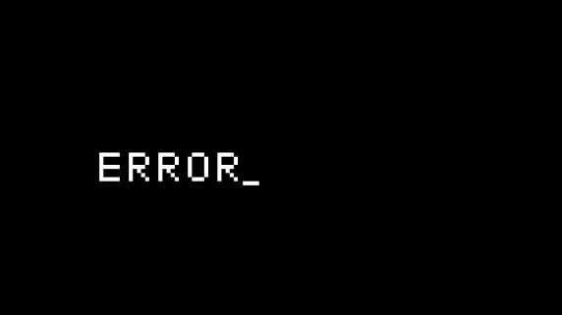
Error Messages
Login error: Username or Password Incorrect, please try again.
Creating a task without a title: Task title is required.

Slide 19
Post Development Testing
Empty task cannot be created.
Except the owner, other Customer cannot view, edit or delete the task.

Slide 20


